Slide 1

NumPy and Pandas
Sara Kokal

Slide 2
Data Analysis
Python is one of the most popular languages for data analysis tasks and ML/DL
NumPy and Pandas are libraries in python.
They provide data structures and tools allowing for the analysis of data.
I am a part of the AIMS research group here at UWEC. I am currently using python and the NumPy and Pandas libraries for my research project. I am using Machine Learning algorithms to identify individuals based on their walking patterns.
The NumPy and Pandas libraries have enabled me to efficiently organize and work with my data so that I can produce worthwhile results that can be compiled and presented.

Slide 3
Pandas

Slide 4
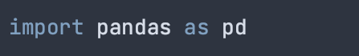
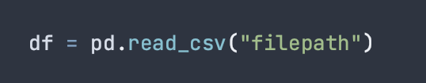
Pandas
Pandas is used for the manipulation of numerical and time series data.
It is mainly popular for importing and analyzing data.
To start using pandas, you first import the library in your chosen Python environment
To start working with your data, you typically import a csv file into a pandas dataframe
Similarly, you can read in a JSON file the same way with pd.read_json()

Slide 5
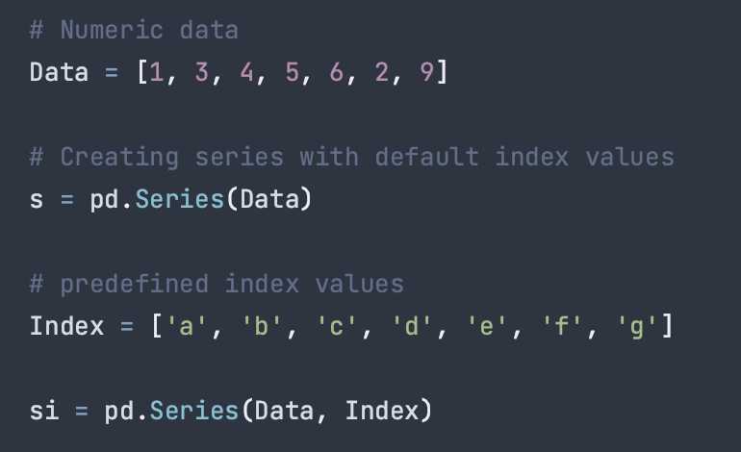
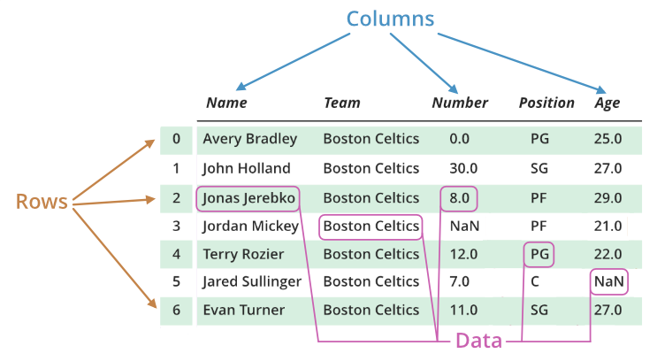
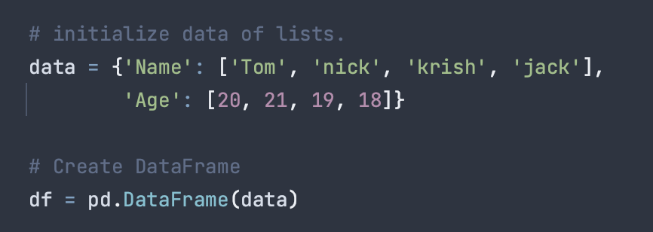
Pandas Data Structures
There are two main data structures used in pandas: Series and DataFrames
A Series is a 1-D array used to store any data type.
It is initialized with “data” and “index” parameters. Your index values can pre-defined or will default to numerical index.
A DataFrame is a 2D representation of a set of data.
It consists of columns, rows, and your data. You can manipulate the size, and it can contain multiple data types.

Slide 6
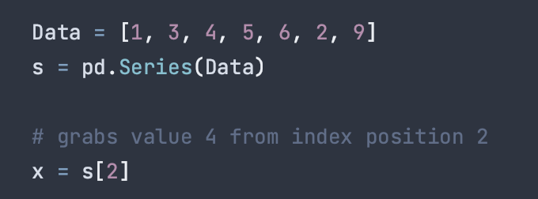
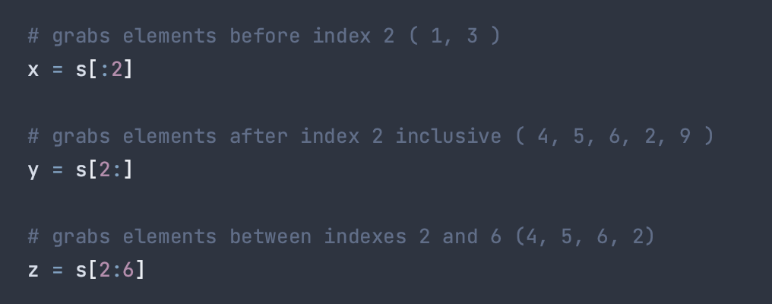
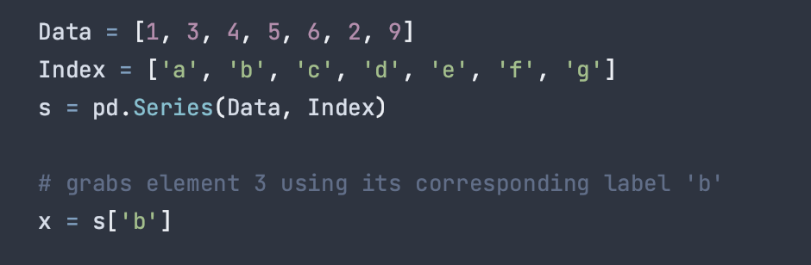
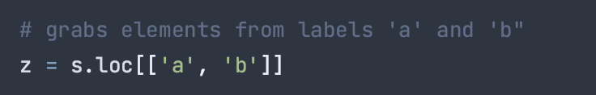
Accessing Elements
There are two ways of accessing elements in a series: position and label
Using position, pandas utilizes integer indices to grab one or more elements from a list. This can utilize python syntax where a “:” can specify everything before or after an index positon.
Using label, pandas can grab one or more elements form a list using the labels of each index.
You can select multiple elements this way

Slide 7
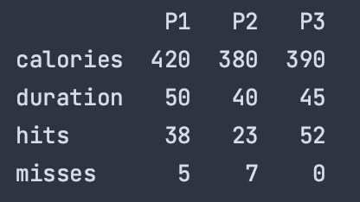
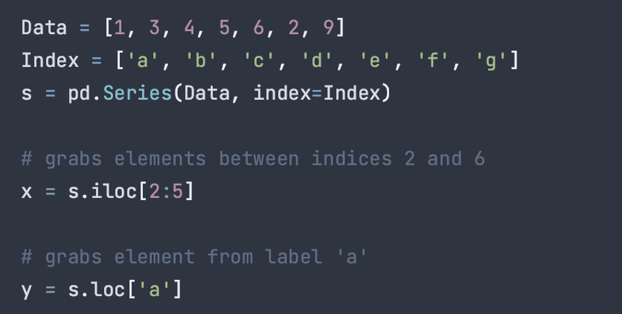
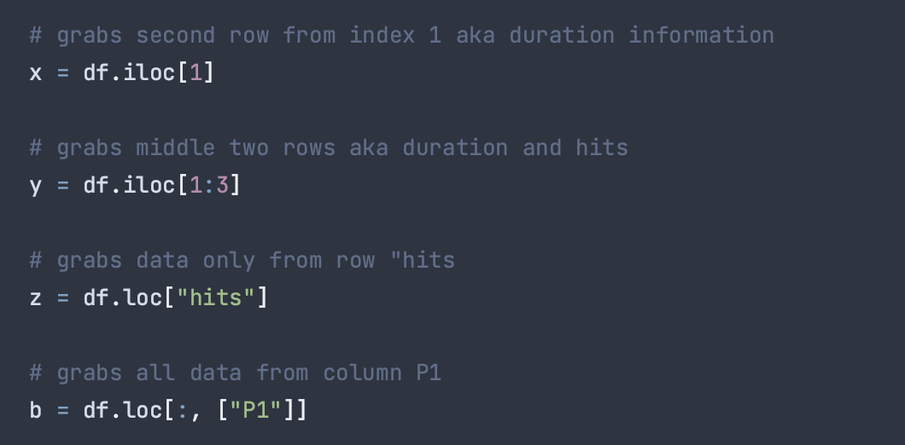
Indexing and Selecting Data
“indexing” means to select a subset of data from a series / dataframe. This can be a collection of elements, a specific row or column, or a chunk of a dataframe
Methods used for this include the .loc() and .iloc() functions.
loc() selects using labels and iloc() selects using integer positions
Unlike python arrays, pandas 2-d indexing goes df[row, col] instead of [col, row].

Slide 8
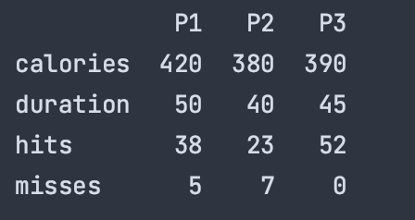
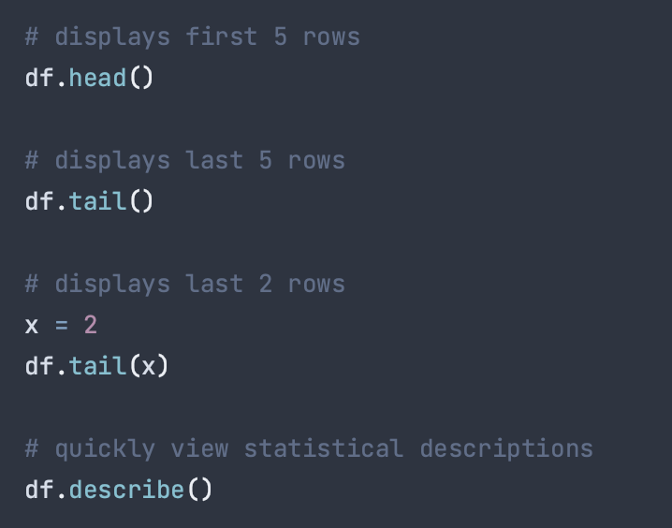
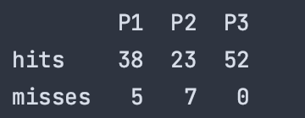
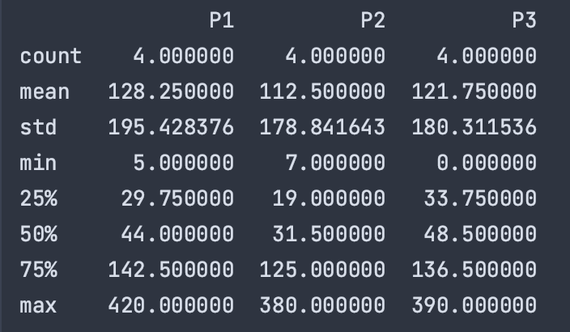
Viewing Data
When working with datasets, it is important to know what you are working with.
.head() and .tail() are two easy functions used to quickly display some of your dataset
They both default to displaying the first/last 5 rows of your dataframe but can take an integer as a parameter to specify how many rows you want displayed.
If you want to quickly see some basic statistical descriptions of your data such as mean, std etc., you can use the .describe() function.

Slide 9
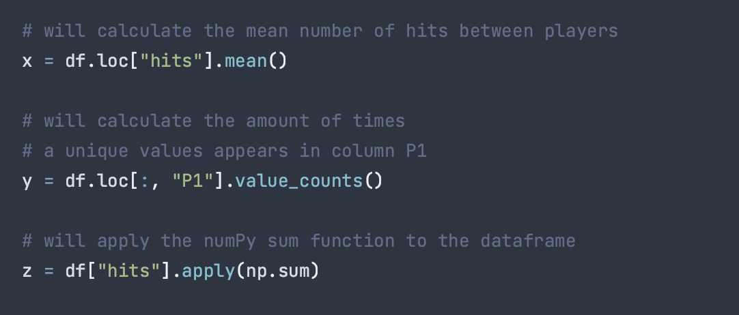
Operations
Pandas includes many functions that can help you easily make calculations with your dataset.
For example:
.mean() will return the mean of the data
.value_counts() will count the number of times each unique value appears
.apply() will take in a function and apply it to your data. This can be a NumPy function.

Slide 10
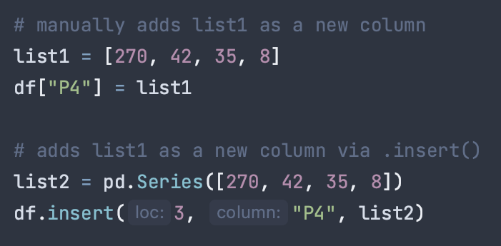
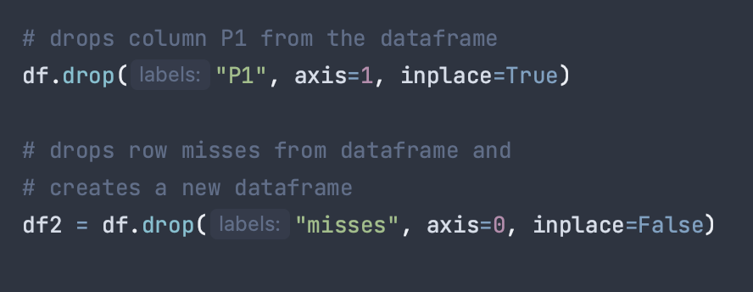
Manipulating Data
Pandas includes many functions and methods to help you easily manipulate data.
To insert a list as a new column in a dataframe you can do it manually or use the .insert() function.
.insert(loc, column, value) are some parameters. loc specifies where we are inserting the column by number, column specifies the name, value specifies the column values
To delete a row/column from a dataframe, we use the .drop() function.
.drop(label, axis, inplace) are some parameters. Label specifies the row/column label. Axis specifies row=0 or column=1. Inplace is a bool. If true, changes are made to the original dataFrame.

Slide 11
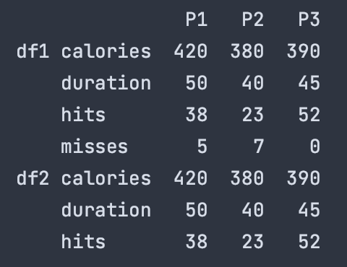
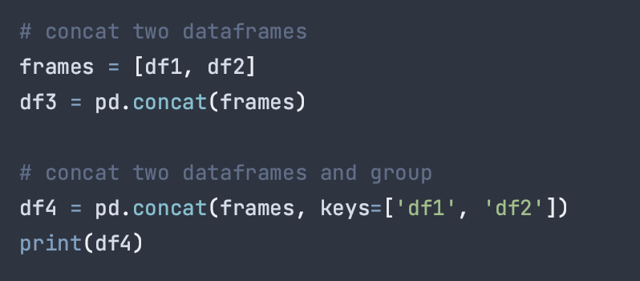
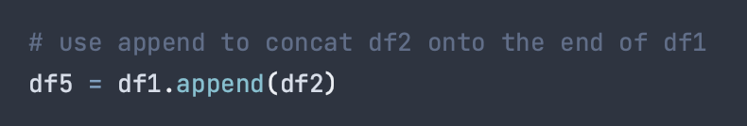
Merging Data
Pandas includes many ways to help you combine relevant sets of data together.
.concat() can be used to concat two dataFrames. The join parameter can be used to specify intersection or union of the dataFrames. If you want to ignore duplicate indexes you can specify parameter ignore_index=true.
The two joined dataFrames can be labeled with keys,
.append() can be used to concatenate along the 0 axis, aka by index.

Slide 12
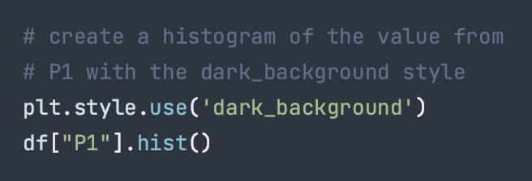
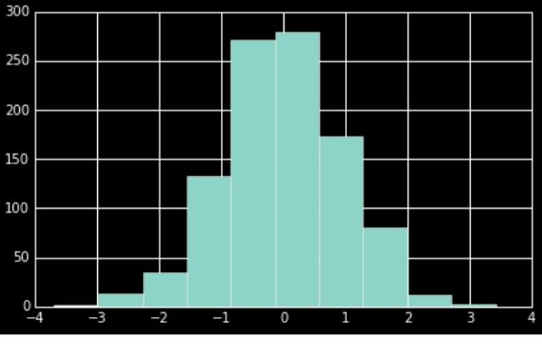
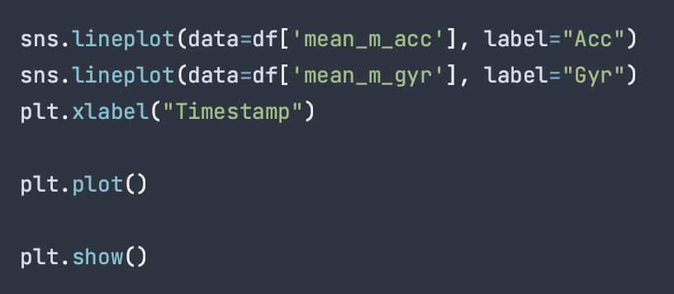
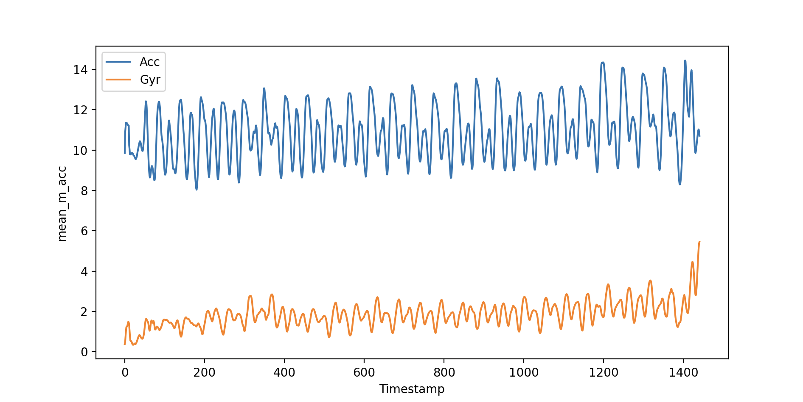
Visualizing Data
Pandas has some built-in capabilities to visualize data using Matplotlib.
.hist() will generate a histogram of your dataframe.
You can specify style with plt.style.use()
Pandas can also use Seaborne package to visualize data. I have used this tool to visualize my own research datasets.
Exampled is a graph depicting the magnetometer and accelerometer sensor readings from an individual as they walk. This helped me decide how to properly average my dataset.

Slide 13
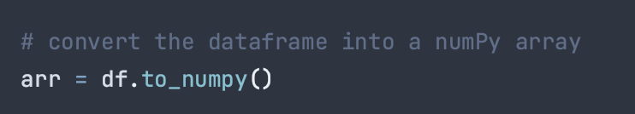
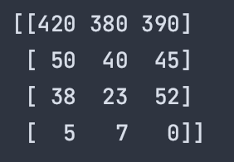
Converting to NumPy
Sometimes, it may be necessary or efficient to convert your DataFrame into a NumPy array. This allows you to use NumPy features that may not be accessible with Pandas on your dataset.

Slide 14
NumPy

Slide 15
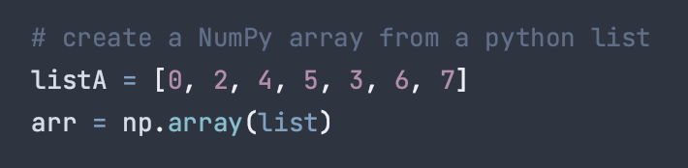

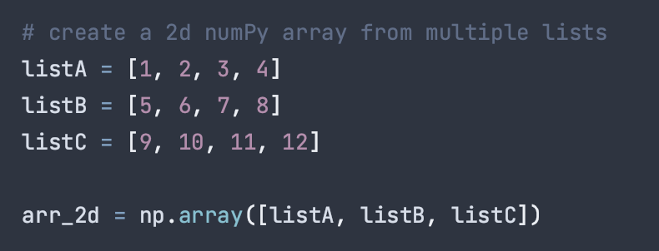
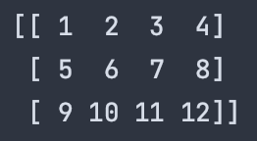
The NumPy Array
Unlike Python lists, NumPy arrays are fixed size. If you want to change the size, you will need to create a new array.
All the elements in a NumPy array should be the same type
NumPy arrays can be one or two dimensional.
NumPy arrays can be made from lists as well as tuples and converted from DataFrames.

Slide 16
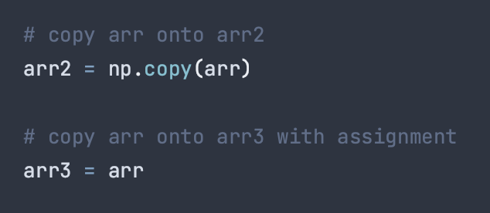
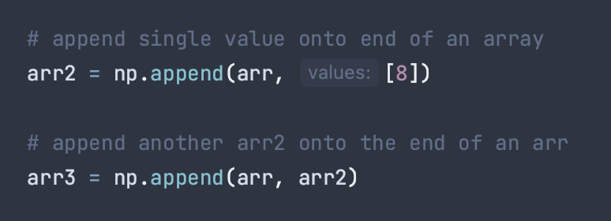
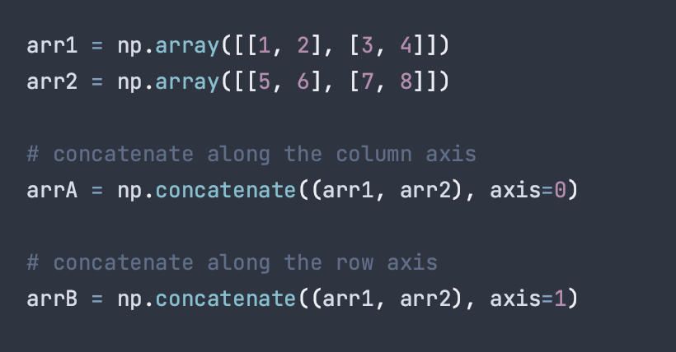
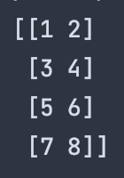
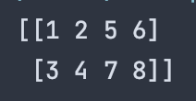
NumPy Array Manipulation
Copying an array onto another array…
np.copy() function
Assignment operator
Append onto an array…
It is important when appending onto an n-dimensional array, the arrays should have matching dimensions
Concatenate two arrays with .concat()

Slide 17
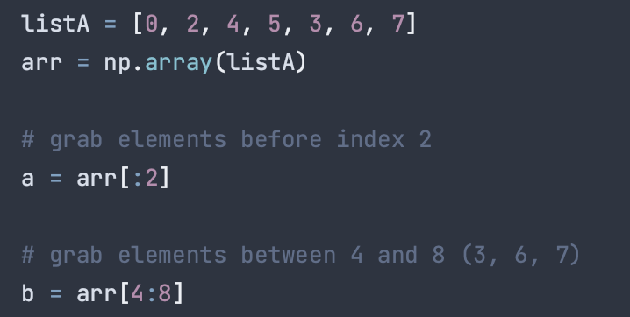
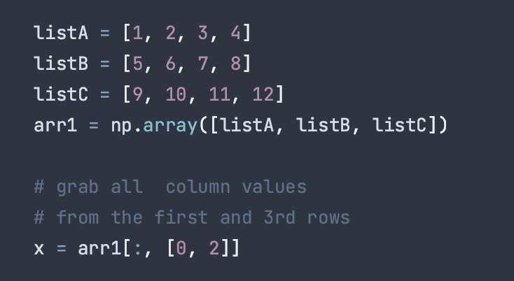
NumPy basic indexing and selecting
NumPy indexing goes by [col, row] like base python, different from Pandas which goes by [row, col].
NumPy arrays also have the similar position indexing rules, where a “:” can be used to grab elements before or after an index position.
Since NumPy arrays are entirely numerical, there is no option for label selection apart from exact index numbers of rows and columns.
You do not need iloc for row/col selection.

Slide 18
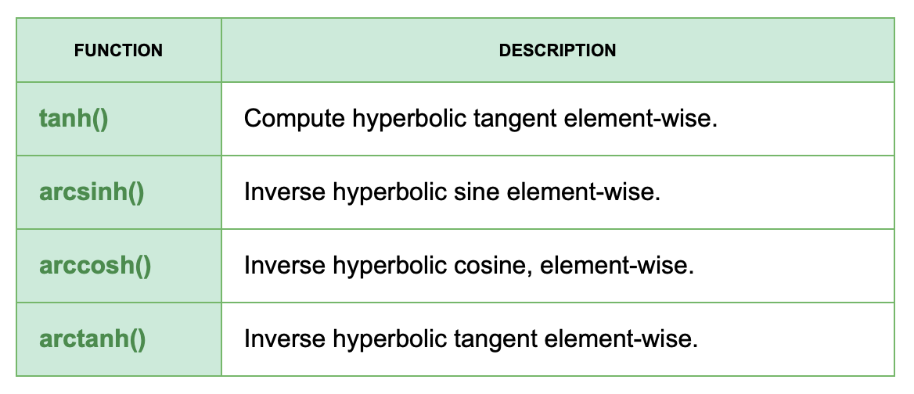
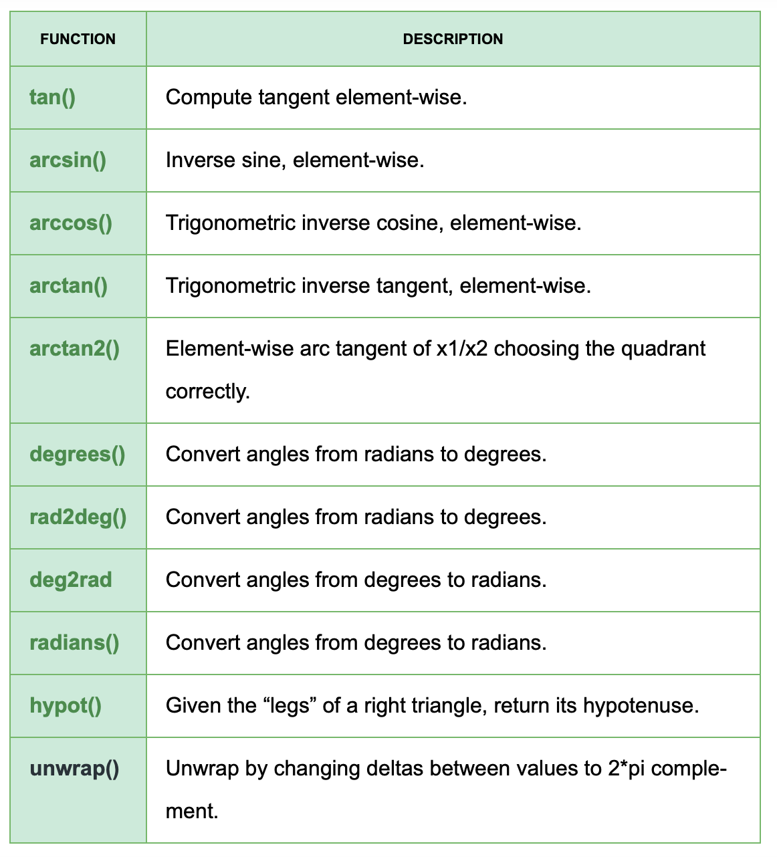
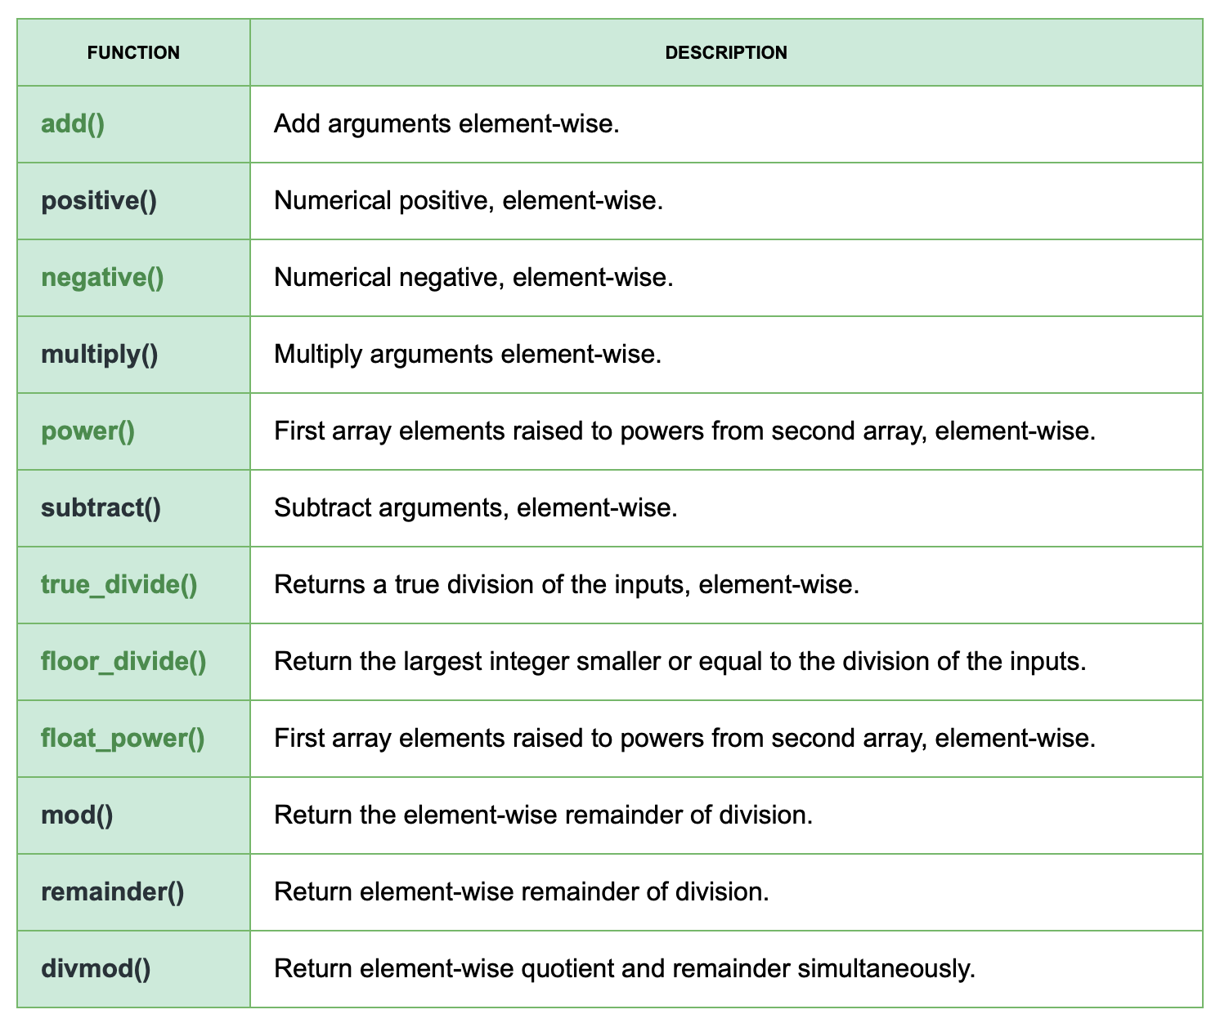
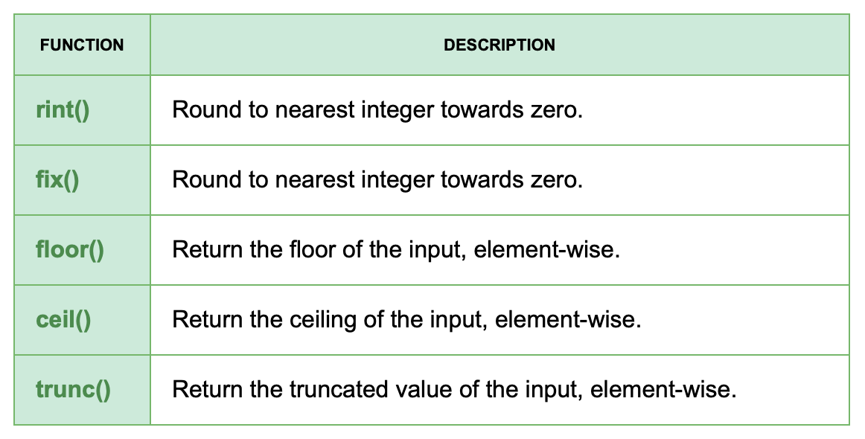
NumPy Array Operations
One reason one may choose to convert a DataFrame into a NumPy array, is due to the abundance and efficiency of numerical calculations available.
NumPy has binary operators that allow for the bit-by-bit computation of arrays including:
bitwise_and(), bitwise_or(), bitwise_xor(), invert(), left_shift(), right_shift(), etc.
NumPy also has many many functions for efficient mathematical computations:

Slide 19
Uses and Comparisons

Slide 20
NumPy vs Pandas
All elements in a NumPy array should be the same type, while Pandas DataFrames can have different types per row/column.
We use NumPy arrays for numerical data, while we use pandas for tabular data.
NumPy use multi-dimensional Array data structures. Pandas uses DataFrames and Series.
Pandas has better performance with rows of <500k, while NumPy arrays perform better with rows of <50k.
Pandas indexing is slower, while NumPy indexing is extremely fast.

Slide 21
Pros and Cons - NumPy
Cons
NumPy arrays hold only one type.
There is a lack of support for missing number values ( This can easily be remedied in Pandas)
Harder to work with large amounts of data compared to pandas.
Pros
NumPy arrays are faster, more efficient, and require less syntax than python sequences.
While NumPy arrays can only hold one type, this makes them more compact and memory efficient as well as eliminating the overhead required to store each type element.
NumPy arrays store elements in adjacent memory locations, allowing for more efficient access.
NumPy library includes an extremely wide range of mathematical functions

Slide 22
Pros and Cons - Pandas
Cons
Pandas can be very memory intensive.
Certain mathematical operations are slower than NumPy.
Has more dependency on external libraries.
Pros
Missing number types (NaN) can be easily fixed in Pandas by replacing with zero or other data cleaning strategies.
Pandas DataFrames can include heterogenous data.
Pandas has precise syntax, allowing you to achieve more with less code.
Pandas can handle large datasets efficiently.

Slide 23
What are Pandas and NumPy Used For?
Pandas
Pandas provides data analysis tools and structures for the manipulating numeric and time series data.
Pandas is great for the preparation / wrangling stages of data science. This involves importing, organizing, labeling, and manipulating the structure and contents.
NumPy
Python lists are a substitute for arrays, but they lack the performance required to analyze large sets of numerical data. NumPy addresses this problem.
NumPy is primarily used for scientific analysis of numeric data. This is great for the calculation stages of data science.

Slide 24

Real World Applications
Pandas and NumPy are mainly used for Data Analysis.
To train ML / DL / AI models, the data needs to be properly preprocessed. Pandas an NumPy and extremely popular tools for this purpose.
Data Analysis is needed for a variety of industries and purposes including…
Statistics, Stock Prediction, Neuroscience, Advertising, Natural Language Processing, Netflix recommendations, and many more.
We are currently in the era of Big data. Data is a global asset that can be used in endless ways. Accessible tools like Pandas and NumPy are invaluable to the future of innovation.

Slide 25
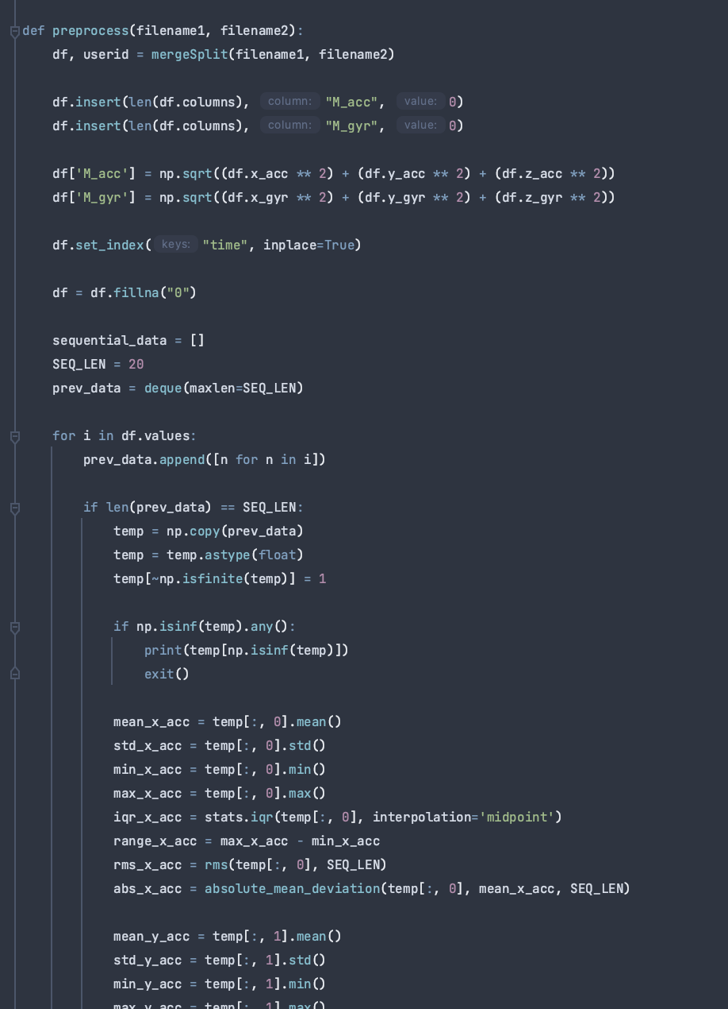
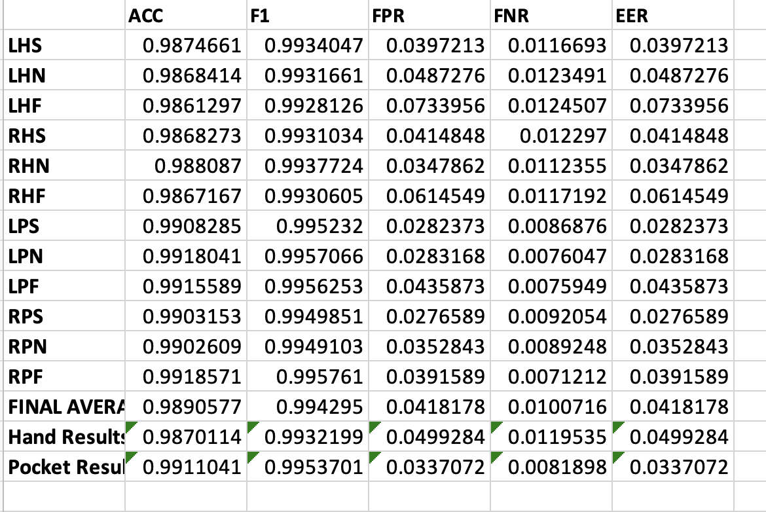
ML/DL Applications
I will use my research project as an example.
For my project, I used pandas for the initial importing, organizing, and manipulation of my time series datasets.
Since my datasets were entirely numerical, I then converted to NumPy arrays and used the indexing and mathematical functions to extract my features.
From there, I exported my features as csv files, and then imported back as DataFrames to train and evaluate my Machine Learning models.
Here are some results form evaluating my data with the Random Forest ML algorithm.

Slide 26
Thank you

